Slide 1
Machine Learning Algorithms
By Astika Nehra
#HourOfCode #CSforGood

Slide 2
Agenda:
What is ML?
Difference between ML, AI and DL!
Supervised and Unsupervised learning
Classification algorithms (KNN, Naive Bayes, Decision tree, SVM)
Regression algorithms (Linear regression, SVR)
Clustering algorithms (K-means)
Deep fake AI
Good Project ideas to begin with!

Slide 3
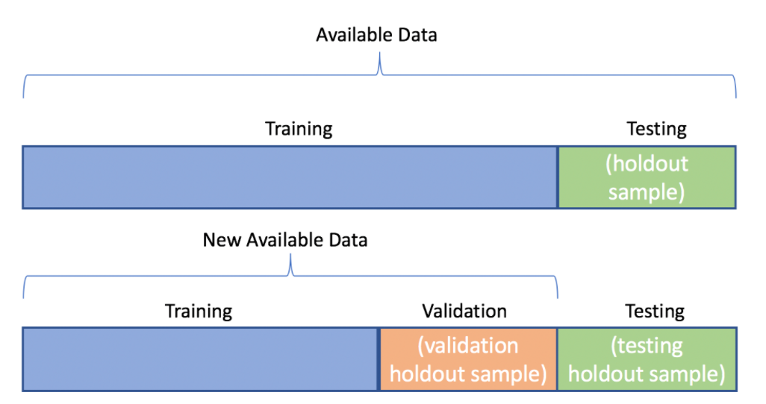
What is Machine Learning?
Machine learning (ML) is the study of computer algorithms that improve automatically through experience.
Machine learning algorithms build a model based on sample data, known as "training data" and are tested on the data called “testing data”. Sometimes on a few models another kind of data is used known as the “validation data” which is used to validate the model performance of the training data.

Slide 4
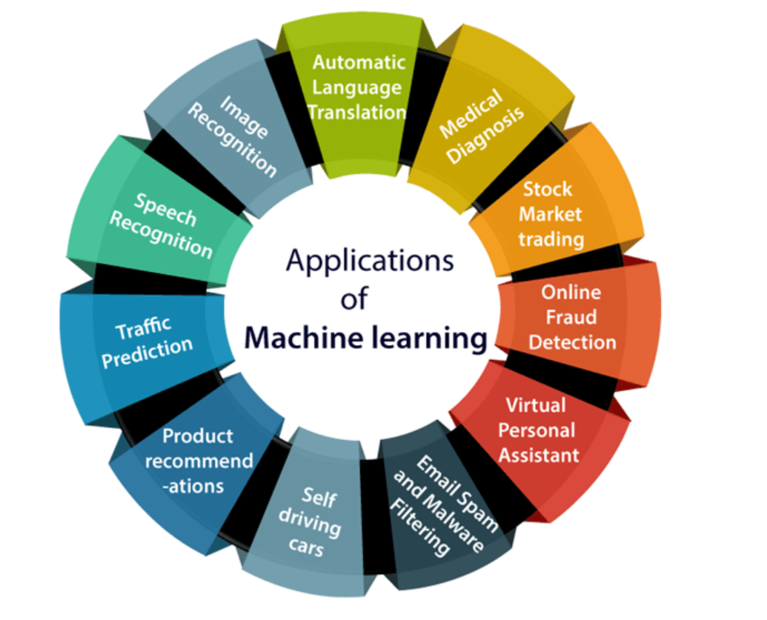
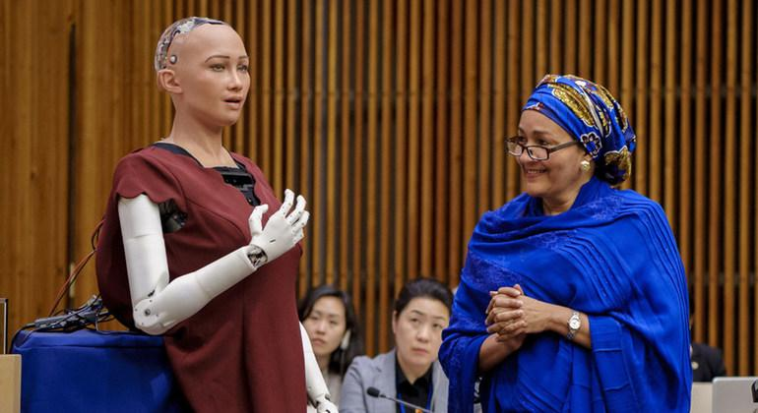
Why the hype?
Human Robot Sophia

Slide 5
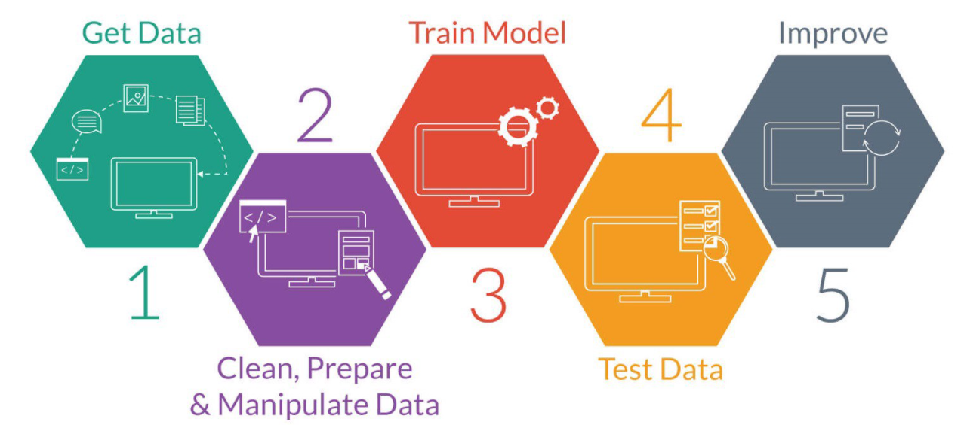

Slide 6
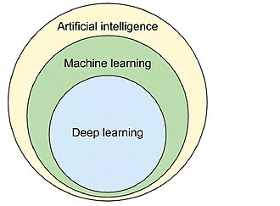
ML, AI and DL??
AI enables machines to think without any human intervention.
ML is a subset of AI that uses statistical learning algorithms to build smart systems.
DL is a technique that is inspired by the way a human brain filters information. It is associated with learning from examples.

Slide 7
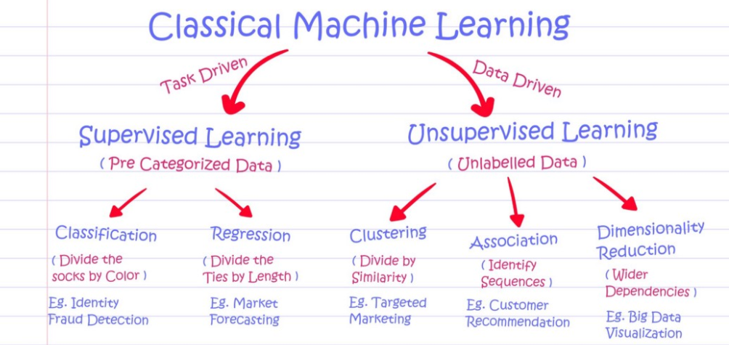
Supervised and Unsupervised algorithms.

Slide 8
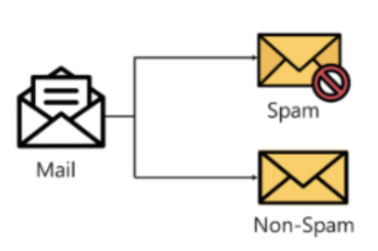
Classification algorithms
Classification refers to a predictive modeling problem where a class label is predicted for a given example of input data.
We’ll be covering following 3 classification algorithms:
KNN
Naive Bayes
Decision Tree
SVM

Slide 9
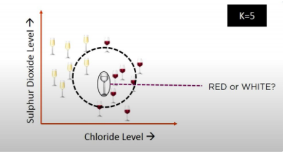
KNN (K-nearest neighbors)
K- nearest algorithm, often abbreviated as KNN, is an approach to data classiﬁcation that estimates how likely a data point is to be a member of one group or another depending on what group the data points nearest to it are in.
K in KNN refers to the number of nearest neighbour to include in the majority voting process.

Slide 10
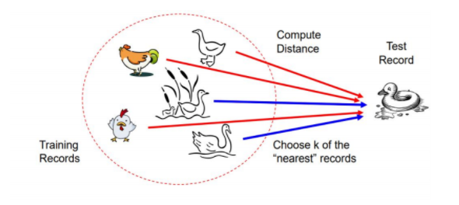
KNN : CLASSIFICATION APPROACH
➤ An object (a new instance) is classified by a majority votes for its neighbour classes.
➤ The object is assigned to the most common class amongst its K nearest neighbours (measured by a distance function)

Slide 11
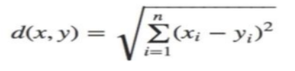
HOW DOES KNN ALGORITHM WORK
Step-1: Select the number K of the neighbors
Step-2: Calculate the Euclidean distance of K number of neighbors
Step-3: Take the K nearest neighbors as per the calculated Euclidean distance.
Step-4: Among these K neighbors, count the number of the data points in each category.
Step-5: Assign the new data points to that category for which the number of the neighbor is maximum.
Step-6: Our model is ready.
The euclidean distance between X and Y is defined as:

Slide 12
Naive Bayes
The Naive Bayes Algorithm is a Machine learning algorithm for classification problems. It is primarily used for text classification, which involves high-dimensional training data sets. A few examples are spam filtration, sentimental analysis and classifying news articles.

Slide 13
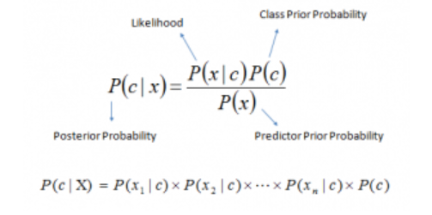
Bayes Theorem
P(c|x) is the posterior probability of class (c, target) given predictor (x, attributes).
P(c) is the prior probability of class.
P(x|c) is the likelihood which is the probability of predictor given class.
P(x) is the prior probability of predictor.

Slide 14
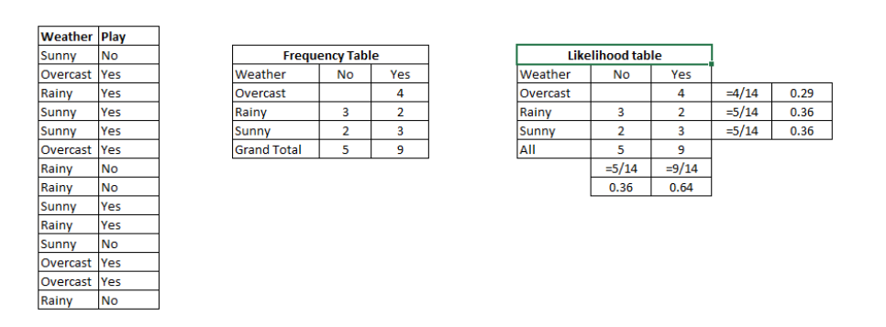
Working of Naive Bayes
Step 1: Convert the data set into a frequency table
Step 2: Create Likelihood table by finding the probabilities like Overcast probability = 0.29 and probability of playing is 0.64.
Step 3: Now, use Naive Bayesian equation to calculate the posterior probability for each class. The class with the highest posterior probability is the outcome of prediction.

Slide 15
Example of Naive Bayes!
Problem: Players will play if weather is sunny. Is this statement is correct?
We can solve it using above discussed method of posterior probability.
P(Yes | Sunny) = P( Sunny | Yes) * P(Yes) / P (Sunny)
Here we have P (Sunny |Yes) = 3/9 = 0.33, P(Sunny) = 5/14 = 0.36, P( Yes)= 9/14 = 0.64
Now, P (Yes | Sunny) = 0.33 * 0.64 / 0.36 = 0.60 (0.6 is closer to 1, hence the class of the above mentioned situation will be “Yes” i:e the player would play)

Slide 16
Decision Tree
Decision Tree is one of the most commonly used, practical approaches for supervised learning. It can be used to solve both Regression and Classification tasks .
It is a tree-structured classifier with three types of nodes. The Root Node is the initial node which represents the entire sample and may get split further into further nodes. The Interior Nodes represent the features of a data set and the branches represent the decision rules. Finally, the Leaf Nodes represent the outcome. This algorithm is very useful for solving decision-related problems.

Slide 17
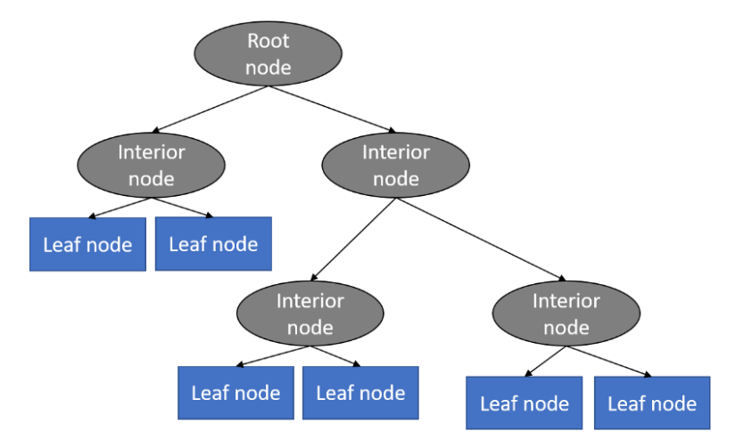

Slide 18
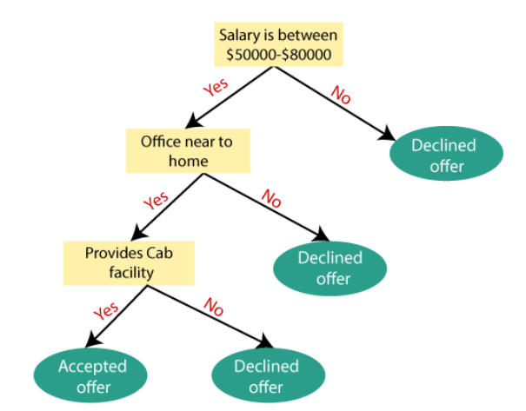
Example on Decision Tree!

Slide 19
SVM (Support vector Machine)
Support Vector Machine, abbreviated as SVM can be used for both regression and classification tasks. But, it is widely used in classification objectives.
The objective of the support vector machine algorithm is to find a hyperplane in an N-dimensional space(N — the number of features) that distinctly classifies the data points.

Slide 20
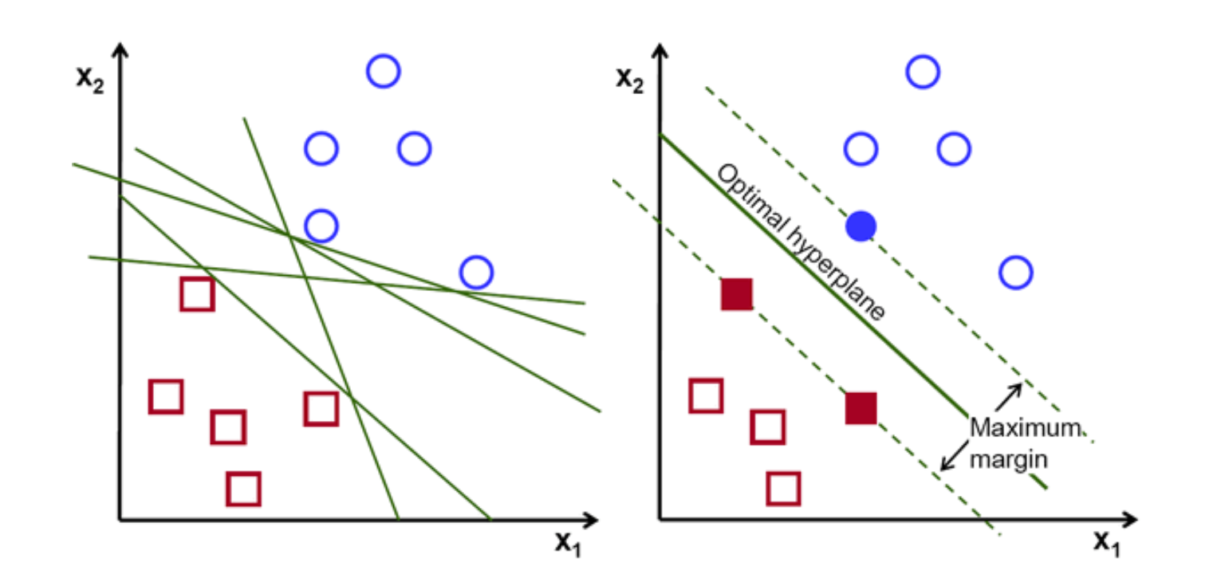

Slide 21
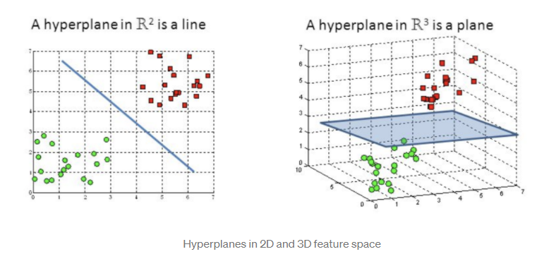

Slide 22
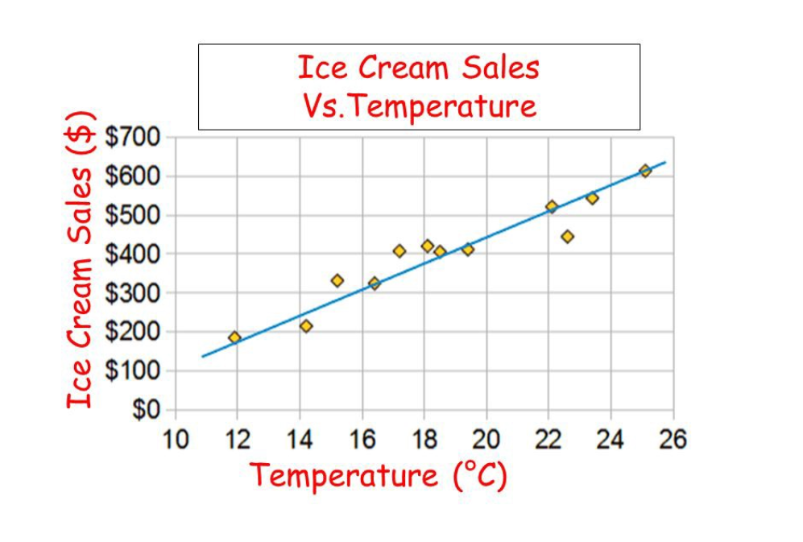
Regression algorithms
The relation between selected values of x and observed values of y (from which the most probable value of y can be predicted for any value of x for the future)
We’ll be covering following 3 regression algorithms:
Linear Regression
Decision Tree
SVR

Slide 23
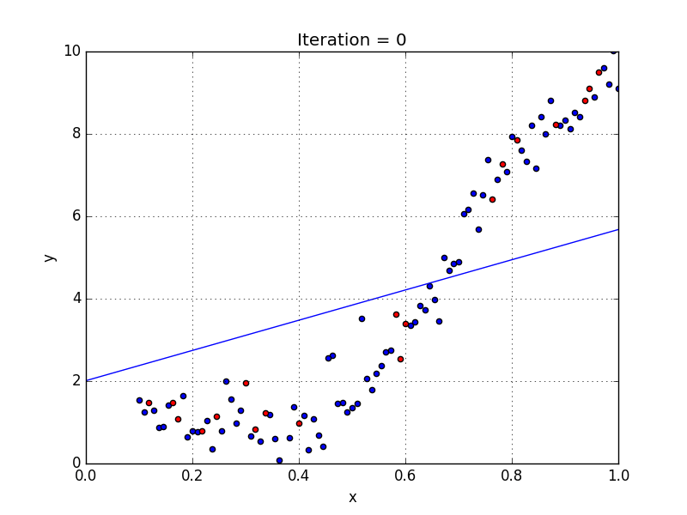
Linear regression
Equation:
Ax+b
A: Coefficient
b: bias

Slide 24
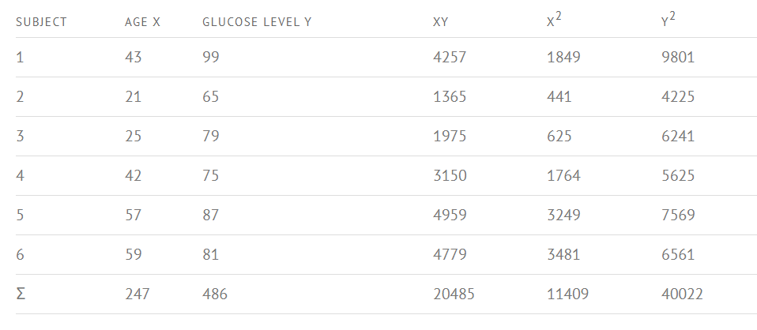
Finding Linear regression equation by hand?
Step 1: Make a chart of your data.

Slide 25
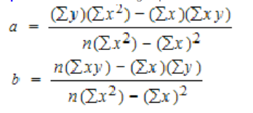
Step 2: Use the following equations to find a and b.
Find a:
((486 × 11,409) – ((247 × 20,485)) / 6 (11,409) – 2472)
484979 / 7445
=65.14
Find b:
(6(20,485) – (247 × 486)) / (6 (11409) – 2472)
(122,910 – 120,042) / 68,454 – 2472
2,868 / 7,445
= .385225
Step 3: Insert the values into the equation.
y’ = a + bx
y’ = 65.14 + .385225x

Slide 26
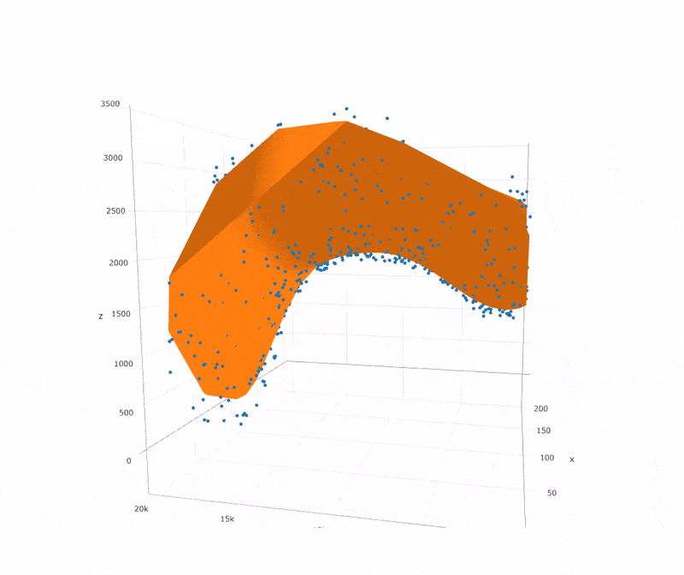
Support Vector Regressor
Support Vector Regression is a supervised learning algorithm that is used to predict discrete values. Support Vector Regression uses the same principle as the SVMs. The basic idea behind SVR is to find the best fit line.
In SVR, the best fit line is the hyperplane that has the maximum number of points.

Slide 27
Clustering algorithm
Clustering is one of the most common exploratory data analysis technique used to get an intuition about the structure of the data. It can be defined as the task of identifying subgroups in the data such that data points in the same subgroup (cluster) are very similar while data points in different clusters are very different.
We’ll be covering K-Means clustering algorithm.

Slide 28
KMeans
We try to find homogeneous subgroups within the data such that data points in each cluster are as similar as possible according to a similarity measure such as euclidean-based distance or correlation-based distance.

Slide 29
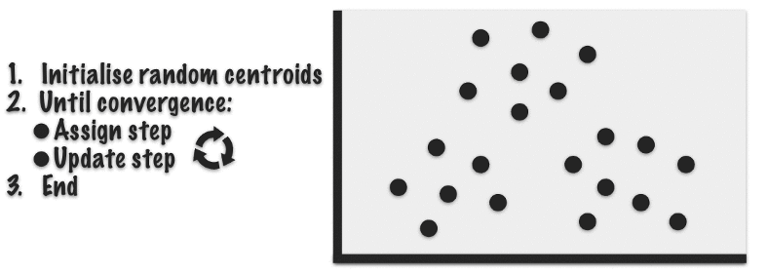
Intuition behind KMeans

Slide 30
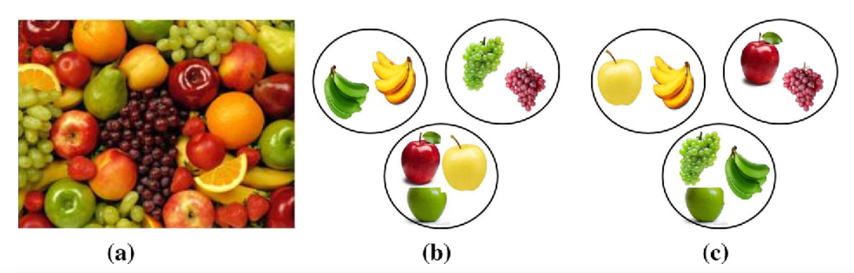

Slide 31
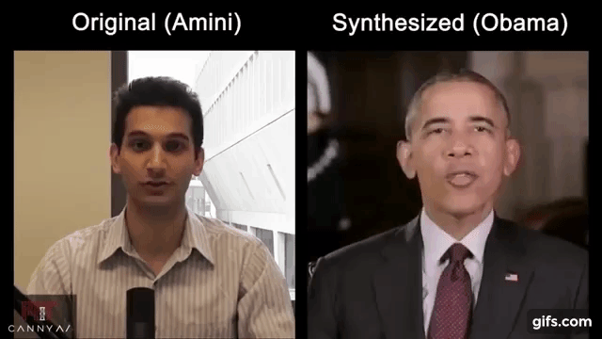
Deep Fake AI
Deep fake (also spelled deepfake) is a type of artificial intelligence used to create convincing images, audio and video hoaxes.
Facial expression of one person and maps it onto the face of another person.

Slide 32
Good project ideas to begin with!
Movie Recommendations.
Stock Price Predictions
Human Activity Recognition with Smartphones.
Sorting of Specific Tweets on Twitter
Turning Handwritten Documents into Digitized Versions.
Sentiment Analyzer.
Healthcare
Prepare ML Algorithms – From Scratch!

Slide 33

Good Luck!
If you have an doubts you can contact me at: astikanehra@gmail.com
You can connect with me at: https://www.linkedin.com/in/astikanehra
Tip: If you want to start with ML, begin with Andrew Ng Coursera course.

